Slide 1

Notes:
Trainer to give a crisp Self Introduction and then introduce FACE.

Slide 2

Customer Centricity 1.1
Topic/Course
What is Customer Centricity?
Notes:
Customer-centricity is a way of doing business that fosters a positive customer experience at every stage of the customer journey. It builds customer loyalty and satisfaction which leads to referrals for more customers.
Being customer-centric means using the customer’s position as the central focal point for all activities within the organization.
Customer-centric organizations develop long term profitable customers and genuine centricity.
A key challenge to becoming customer-centric is overcoming two of the most common misconceptions, i.e., that customer centricity is only about customer service, and secondly that it requires organizations to respond to all customer needs.

Slide 3
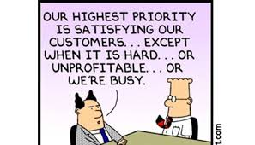
Sub-Topic (Example: name of college)
Notes:
Customer Centricity is “ALWAYS” The Highest Priority!!!

Slide 4
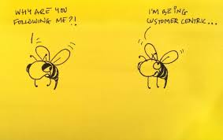
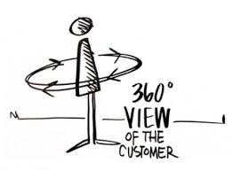
Topic/Course
Notes:
The Customer needs to be the Central Focal Point and the Complete 360 Degree View of the Customer needs to be analyzed.

Slide 5
How to be Customer Centric?
Listen to your Customers
Remember: Customer perception is reality
Make your Customers part of the solution
Map your Customer’s journey
Monitor Customer interactions
Notes:
Trainer to now explain that we are going to look at the different ways to be Customer Centric. In the slides that follow, Trainer to ask Students to illustrate examples for each.

Slide 6
How to be Customer Centric?
Get your data together
“See” your Customers digitally
Define your Customer experience strategy
Empower and reward your employees
Notes:
Trainer to now explain that we are going to look at the different ways to be Customer Centric.

Slide 7
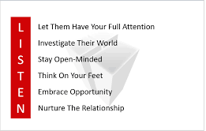
Listen to your Customers
Sub-Topic (Example: name of college)
Notes:
We’re not simply talking about satisfaction surveys or asking “the ultimate question” to track a Net Promoter score--though this can be part of the equation. The issue with these solutions is that they don’t point toward the problems or delights that drive those scores. Listening to your customer means asking them what they think--and why. Then acting on it.

Slide 8
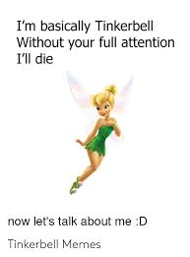
Let Them Have Your Full Attention
Sub-Topic (Example: name of college)
Notes:
You need to give Customers Your Full Attention, else Your Competitor will. Now, everyone knows what will happen then. So, do you want to lose your customer to your competitor?

Slide 9

Investigate Their World
Sub-Topic (Example: name of college)
Notes:
Investigate everything that revolves around the Customer and everything that the Customer revolves around.

Slide 10

Stay Open Minded
Sub-Topic (Example: name of college)
Notes:
Remember to Stay Open Minded to your Customers. An idea or suggestion may sound crazy, but on investigation, may prove to be mind blowing and revolutionize your business. So, do not just dismiss anything without checking it out completely.

Slide 11
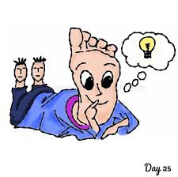
Think On Your Feet
Sub-Topic (Example: name of college)
Notes:
React to events decisively, effectively, and without prior thought. The Customer needs you to Listen to them and do what? Nothing? Just Listen patiently? Listen And Take Action!!! IMMEDIATELY!!!

Slide 12

Embrace Opportunity
Sub-Topic (Example: name of college)
Notes:
Whenever an Opportunity comes, Embrace it immediately. If you do not open the door when Opportunity knocks on your door, Opportunity is going to knock on someone else’s door, and that someone is going to Embrace it before you.

Slide 13
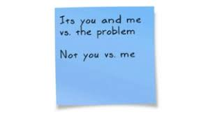
Nurture The Relationship
Sub-Topic (Example: name of college)
Notes:
If the Customer has any issue, take on the issue as your own. This will nurture your Customer Relationship and will also help you to gain valuable insights for your future growth.

Slide 14
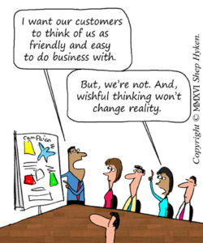
Remember: Customer perception is reality
Notes:
The quality of your customer experience lives in one place: the mind of your customer. No matter how well you think you’re doing, the gap between customer expectations of experience and their perceptions of actual experience is the reality you need to understand and address.

Slide 15

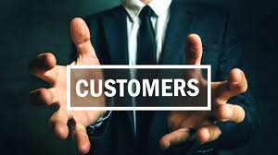
Make your Customers part of the solution
Topic/Course
Sub-Topic (Example: name of college)
Notes:
Involving the customer in the design process--experiences, services, products, or physical environments--has been around for a long time. It boils down to this: Don’t make decisions about what your customers might want or need without taking their point-of-view into account.

Slide 16
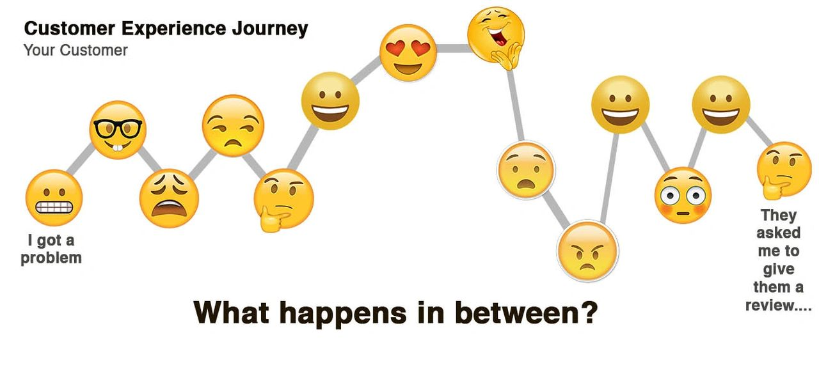
Map your Customer’s journey
Sub-Topic (Example: name of college)
Notes:
A customer journey map allows you to “walk in your customers’ shoes” by traveling with them as they interact with your company. Research-based and focused on desired outcomes from the customer’s perspective, you’ll see what their needs are at each interaction, how well you meet them, and where opportunities for improvement lie.

Slide 17

Monitor Customer interactions
Notes:
Monitoring is critical because only you know all your touch points. Pulsed, planned, or transactional surveys, call centre logs, complaint lines, web feedback and social media commentary--monitor your performance in all of these places, and more. Set KPIs based on customers expected and your planned experience, and monitor to see how well you do.

Slide 18

Get your data together
Notes:
Most established companies keep customer data in silos across the enterprise: sales data, marketing data, product and service data and digital data- all in different buckets. All of this customer data needs to be integrated and easily accessible across the organization, so employees can truly “see” the relationship between the organization and the customer, and make decisions as a result. This is one of the greatest challenges faced by big companies, and one of the most important to solve.

Slide 19

“See” your Customers digitally
Notes:
Every transaction between the Company and the Customers generates data about that transaction. Each online or mobile interaction generates “digital data trails” that can be stored and analyzed. Looking at your customers through the lens of your digital relationship will provide valuable insights into behaviour that can help you radically improve Customer experience.

Slide 20
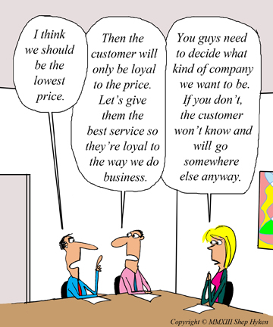
Define your Customer experience strategy
Notes:
Customer experience strategy flows from your company’s business and brand strategy. Just as brand strategy creates (and manages) customer expectations of a brand, your customer experience strategy is your plan to meet or exceed those expectations. With implications for virtually every aspect of your company, it’s the vehicle through which you can turn customer expectations into reality.

Slide 21

Empower and reward your employees
Empower employees to make decisions to support the customer.
They should not have to ask permission
To do something that seems like
Common sense
People work for money, but go the extra mile for recognition, praise and rewards
Dale Carnegie
Notes:
In the quest to be more customer-centric, employees are the frontline. They boast a wealth of insight about customers and internal operations, and can quickly improve customer experience through one-on-one interactions and behind-the-scenes decision-making. Yet many companies have reward structures tied only to revenue, versus meeting the needs of customers. They don’t empower employees to make the decisions required to meet those customer needs.

Slide 22
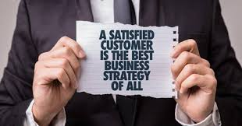
Tips for Becoming a Customer-Centric Organization
Notes:
Trainer to explain that we are going to look at some tips for “Becoming a Customer- Centric Organization”.
While becoming a customer-centric organization seems like a straightforward concept, there are a few challenges involved. It takes time to totally revamp company culture, build lines of communication between employees and customers, and implement new features. Creating a plan to follow-through will help ensure success.
Establishing customer-centricity as a core value and then communicating it to employees is only the first step. The value needs to become deeply ingrained in company culture and expressed at every available opportunity, no matter how small. Keeping lines of communication open with customers is also integral, as is evaluating their feedback and turning it into actionable insights. Luckily, the right tool can make the job easier.

Slide 23

Company Culture
Notes:
Build a “Company Culture” of “Customer Centricity”:
Building a customer-centric company culture is not as simple as throwing a few motivational posters up around the office and calling the job done. It starts with an intentional strategy executed at multiple points of the employee experience.
The first step is the make customer-centricity a core value of the company (if not a part of the mission statement), then stick with it. When Amazon was starting out, they set forth with the mission to be “Earth’s most customer-centric company.” They are doing a pretty good job at it.
Do not expect to announce the core value in a company-wide memo and see a massive overnight change in how employees operate. Instead, hold an employee training or retreat that introduces the value and encourages employee buy-in.
Better yet, consider bringing employees into the initial conversation where new core values are being discussed and set. This can massively increase their sense of ownership over the value and make it easier to spread and adopt.
The next step would be to hire the right employees who will uphold that core value to the highest extent possible and be an asset to company culture. This might also mean having to let go of team members who have a hard time or refuse to get on board with the new direction.
It is also important to get everyone involved in customer service. Another benefit of getting everyone involved is that it sets an example for other employees. When they see upper-level management getting down in the trenches to deliver excellent customer service, they will feel more compelled to do the same.
From time to time it may be necessary to deliver reminders to employees about the importance of customer centricity. These might come in the form of refresher training, emails sharing internal customer-centric success stories, or partnering up employees on assignments so that they can learn from one another.
Finally, reward employees who have a unique customer-centric success story or a track record of giving great customer service. Monetary or material prizes work great, but depending on the employee some verbal recognition works just as well. In any case, it pays to let employees know that they are appreciated when they value the customer.

Slide 24

Getting in touch
Notes:
Give customers multiple ways to “Get in Touch”:
With a team of customer-centric employees at hand, it is time to facilitate communication with customers. Although it might go without saying, a good rule of thumb is that the easier it is for customers to get in touch, the better.
Rackspace, with their “fanatical” customer service, puts their contact options front and centre. Their call, chat, and email channels are displayed even more prominently than the menu bar exploring their product and features. They know that if they can get a potential buyer or customer into a conversation, they can deliver better support than product information pages or knowledge base articles ever could.
Salesforce also makes it extremely easy for customers to get in touch. Their phone number is clearly visible, as are additional contact options. Plus, there is a floating chat box in the bottom right corner for visitors who might have just a few simple questions.
Zendesk, on the other hand, is not as straightforward. Their first contact option (the “Contact Us” link) is minuscule and shoved in the top right corner. It adds an extra step for customers or potential buyers.
There is a floating button in the bottom right corner of the page that gives visitors the option to contact sales, but some people might be turned off. Maybe they just have a few questions but are not ready to be pitched to yet, or maybe they are already a customer and have no need to talk to sales. In any case, these contact options do not necessarily make customers’ lives any easier.
Another way to facilitate customer relationships is by hosting in-person events and networking opportunities.
SoFi, a personal finance company, hosts “member experiences” around the country that allow customers to receive live financial advice, go to workshops, and expand their network. Plus, SoFi promises that these events “are not sales experiences and never will be.”
SoFi is also honest about what they get out of the deal, saying, “It gives us a direct channel to interact with and get feedback from our members in a relaxed setting.”

Slide 25

Customer Feedback
Notes:
Collect, Analyze, and Implement Customer Feedback:
Speaking of feedback, what use is hearing it if nothing is done? Collecting, analyzing, and implementing customer feedback from across multiple channels is key to developing a product or service that customers cannot help but be loyal to.
Wonderflow’s Wonderboard compiles customer feedback and then visually displays all the pros and cons of a particular product or service. There is also an option for comparing multiple products so that you can see how they stack up against each other.
The Wonderboard draws feedback from reviews, surveys, internal data, and more, making it a comprehensive tool for understanding how customers feel. This sort of data analysis takes all the guesswork out of knowing what customers are thinking so companies know exactly where they stand.
That is not all the Wonderboard can do. It uses a proprietary technology of Natural Language Generation to create insights about customer feedback. This helps company leaders and developers understand exactly what needs to be improved and what strengths are worth holding on to.
Being customer-centric is not just about offering unparalleled support. It is about offering a product or service that meets customer needs in every possible way. A feedback analytics tool can help do just that.

Slide 26
Activity
Delighted by the service as a customer
Depressed by the bad service as a customer
Notes:
This is an interactive activity.
The duration of the activity is 10 minutes
The trainer has to ask two types of experiences from the students that happened in their life
Delighted by the service as a customer
Depressed by the bad service as a customer
They can tell any experiences in buying a product which delighted them or stressed them.
Get the response from the students

Slide 27
RECAP ANYONE ?
Notes:
Trainer to ask anyone to re- cap.

Slide 28
RECAP ANYONE ?
How to be Customer Centric?
Listen to your Customers
Remember: Customer perception is reality
Make your Customers part of the solution
Map your Customer’s journey
Monitor Customer interactions
Notes:
If any points were left out in the re- cap, Trainer to mention the same and then do a Final Re- Cap.

Slide 29
RECAP ANYONE ?
How to be Customer Centric?
Get your data together
“See” your Customers digitally
Define your Customer experience strategy
Empower and reward your employees
Notes:
If any points were left out in the re- cap, Trainer to mention the same and then do a Final Re- Cap.

Slide 30
RECAP ANYONE ?
Tips for Becoming a Customer-Centric Organization
Company Culture
Getting in touch
Customer Feedback
Notes:
If any points were left out in the re- cap, Trainer to mention the same and then do a Final Re- Cap.

Slide 31
Activity 1
Describe Customer Centricity in your own words.
Notes:
Trainer to ask Students to write down and then discuss. Activity to take five minutes.

Slide 32
Activity 2
Write any three incidences that you came across with you as a Customer, that made you feel that the Organization that you were dealing with is Customer Centric.
Notes:
Trainer to ask Students to write down and then discuss and compare. Activity to take 15 minutes.

Slide 33
Activity 3
A Life Insurance Company has embarked on an enterprise-wide focus on Customer Centricity with the objective of providing the desired customer experience across the customer journeys. In relation to this, it has implemented numerous initiatives to address customer pain points and improve customer communications. What do you think would be the ideal initiatives?
Notes:
Examples of Initiatives:
Application process enhancement by simplifying the application form and migrating paper-based application to digital application form
Payment facility via E-Pay that enables customer to pay their initial premium during the application process without the need to go to any branch or accredited bank
Enhanced customer communication via short messaging service (SMS) to acknowledge receipt of application, provide status update and confirm approval
Welcome email to enhance customer on boarding where customers receive an electronic copy of their insurance policy contract, they are informed on the customer portal, an online access to self-service that empowers them to transact anytime, anywhere and on the available payment channels to promote payment convenience
Enhance the welcome call program to educate customers on the benefits of their insurance policy and membership
Check accuracy of encoded customer contact details via Welcome Call to ensure customer will receive company-initiated service notifications and correspondence
Implement targeted customer offers to enable reinstatement of lapsed customers
Launch e-claims submission via customer portal. This allows convenient submission of claims transactions and faster release of claims benefits
Launch Premium Club. The program is the company’s way of rewarding the trust of its customers with exclusive perks and wellness benefits, allowing them to experience the brand’s promise of helping people live healthier, longer and better lives
Conduct customer journey mapping training and workshop to foster enterprise wide collaboration and integrated view of the customer enabling alignment of internal processes and service levels to deliver better customer experience
Appointment of Data Protection Officer to ensure that confidential and sensitive data and information of the customers are protected.

Slide 34

THANK YOU
Notes:
Trainer to Thank the Students saying that it was a good session and re- iterate the usefulness of the session.

